Slide 1
uber supply demand mismatch analysis
Satyaki Ray

Slide 2
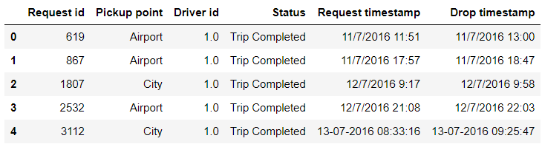
Initial data exploration

Slide 3
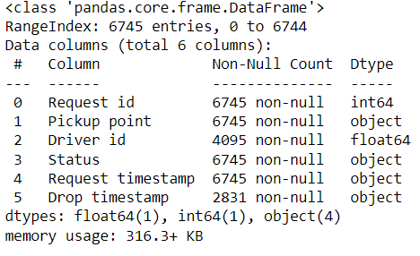
Missing values

Slide 4
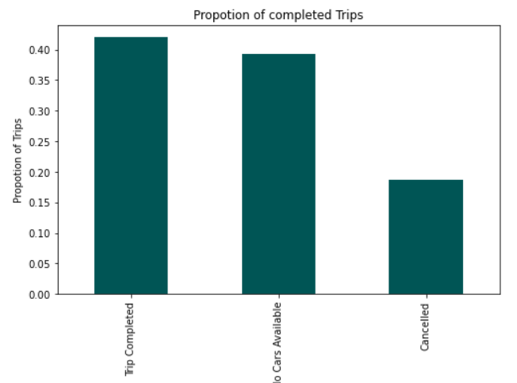
Segregation of data by trip status

Slide 5
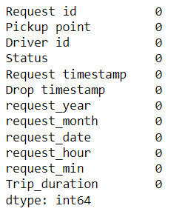
Missing values for completed trips

Slide 6
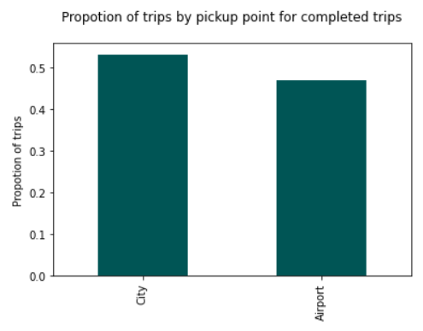
Segregation of completed trips by pickup point

Slide 7
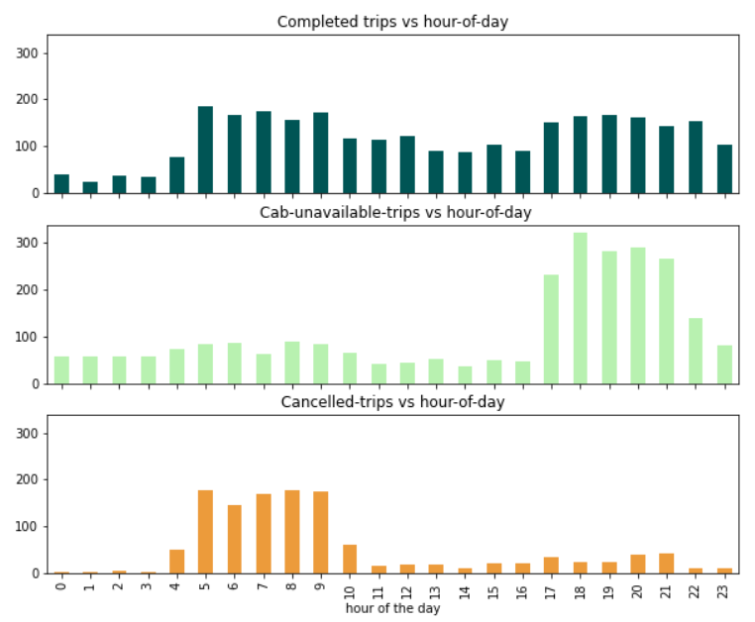
Trips by hour of the day

Slide 8
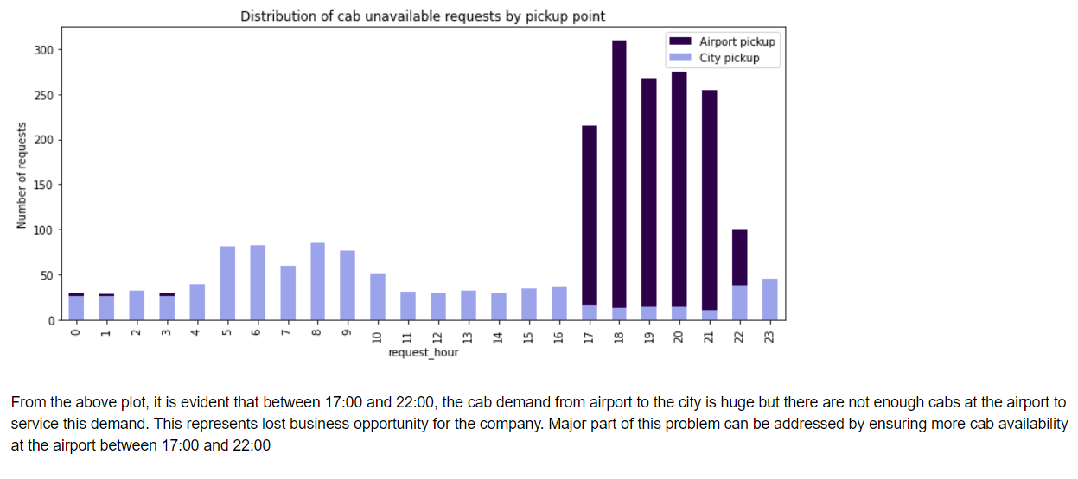
Exploring cab unavailability

Slide 9
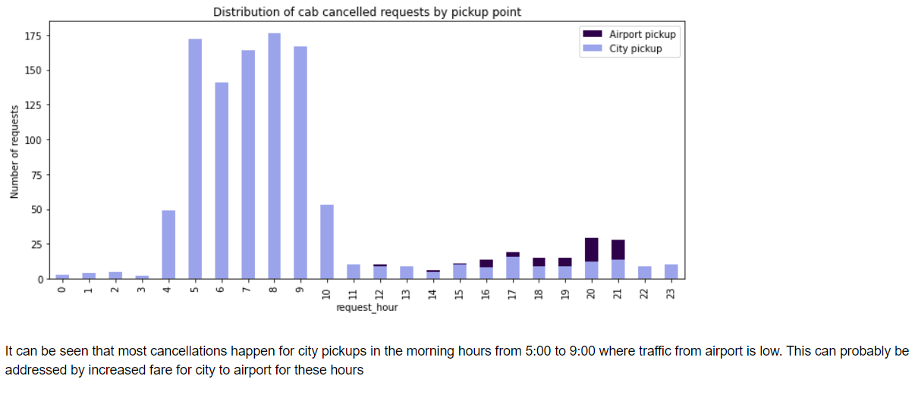
Exploring cancelled trips

Slide 10
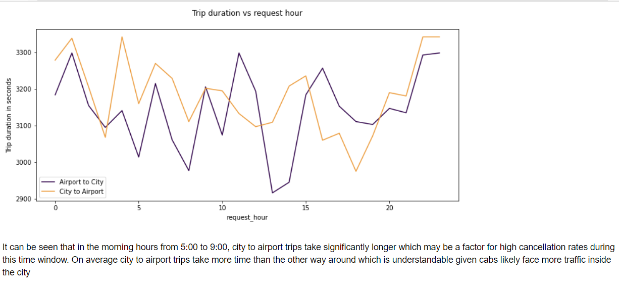
Exploring trip duration

Slide 11
Additional information
Link to code https://github.com/Satyaki9207/uber-supply-demand-mismatch-analysis

